Slide 1
AUGMENTED SPORTS SYSTEMS
By Jacob Sphatt
Division of Science and Mathematics
University of Minnesota Morris
Morris, Minnesota

Slide 2

Dodgeball
Notes:
A little boy wanted to play dodgeball with his friends who are much older and higher skilled. He then plays dodgeball with his friends and doesn't like playing dodgeball. A augmented dodgeball system would be perfect in this scenario by leveling the playing field.

Slide 3
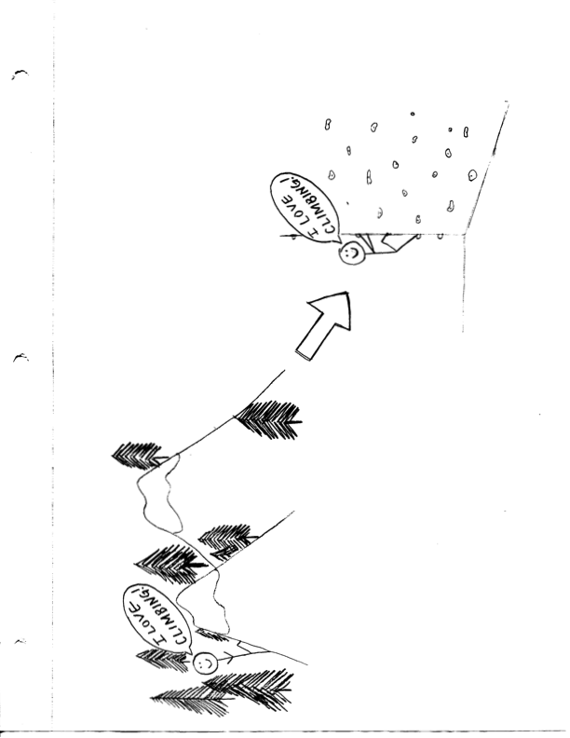
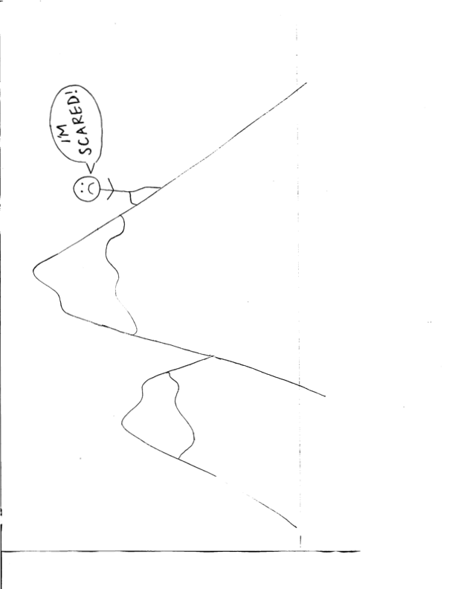
Climbing
Augmented Wall Climbing
Notes:
When you have a fear of heights and like climbing mountains but can't always climb a real mountain. An augmented wall climbing system would be a perfect solution because you can climb at a safe measure and anytime you want while having fun.

Slide 4
OUTLINE
Introduction
What is augmented reality?
Comparing virtual and augmented reality
Why use an augmented sports system?
What is an augmented sports system?
Example systems
Dodgeball – game
Wall climbing – perceptions/experience
Conclusion
Notes:
wall climbing focuses on augmenting the user's perceptions and experience rather then augmenting the game

Slide 5
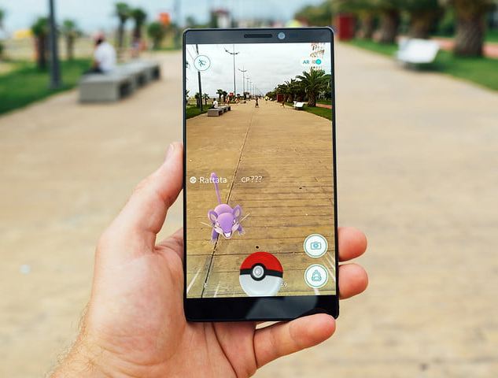
WHAT IS AUGMENTED REALITY (AR)?
Technology that modifies
the perceptual information
of an individual in the
real world
Notes:
AR is when the technology modifies the experience of an individual in the real world. An example of augmented reality is pokemon go. This game allows a user to catch virtual pokemon that are hidden throughout the map of the real world.

Slide 6
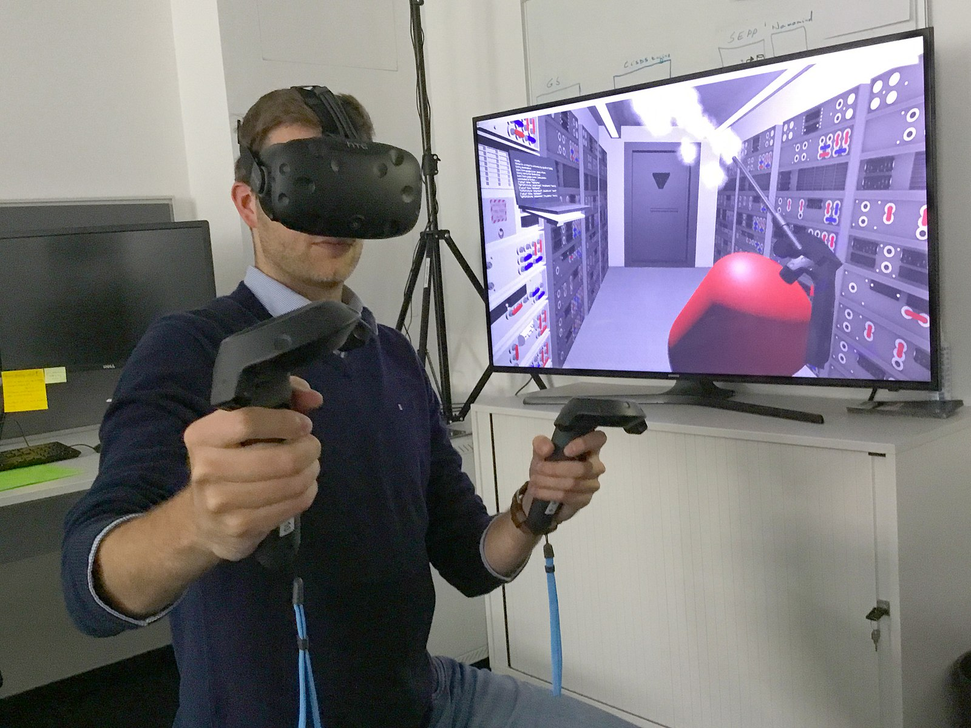

VIRTUAL REALITY (VR)
VS.
AUGMENTED REALITY (AR)
Virtual world where many perceptions are constructed by technology
Replace the whole experience
Technology changes the experience of the real world
Changes part of the experience
Notes:
Fully immersed in a virtual world where many perceptual inputs are constructed by technology. Aims to replace the experience.
Technology changes the experience of the real world. Only changes part of the experience.

Slide 7
WHY USE AN AUGMENTED SPORTS SYSTEM?
Increases skill
Enjoyable
Social interaction
Physically active
Safe environment
Notes:
Using an augmented system increases skill by creating a opportunity for practicing to get better.
Enjoyable because it creates a level playing field.
Social interaction because when you are enjoying yourself you tend to socialize more.
Encourages people to be physically active.
Safer solution like the exmaple of phil

Slide 8
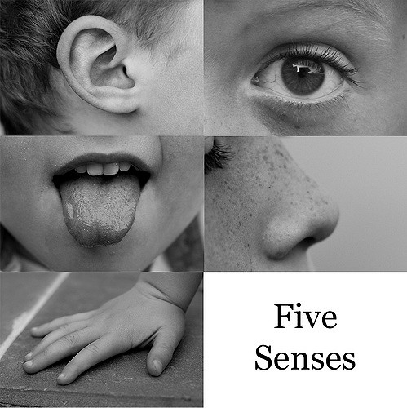
WHAT IS AN AUGMENTED SYSTEM?
Add features
Alters player’s experience
Perceptual information
Notes:
add features by altering the player's experience either through an embedded system or by some perceptual experience of a player.

Slide 9
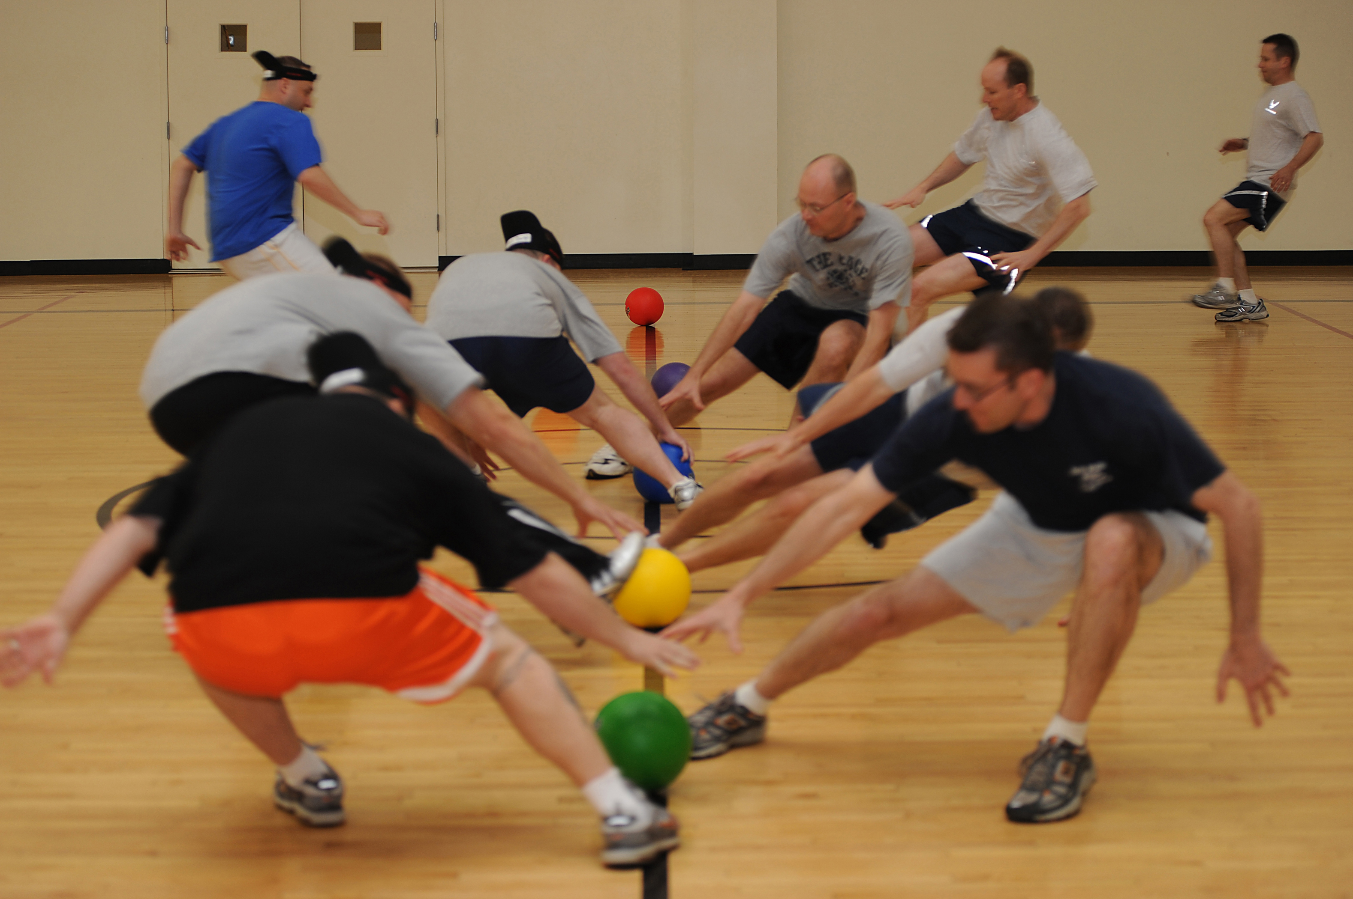
DODGEBALL
Notes:
Dodgeball is a game where players on two teams throw balls at each other while avoiding being hit. objective of the game is too eliminate all opposing members. inducing critical thinking, and strategic and competitive behavior.

Slide 10
EXPERIMENT
16 participants (14 male, 2 female)
Ages between 20 and 26
No previous experience with playing dodgeball with an augmented system

Slide 11
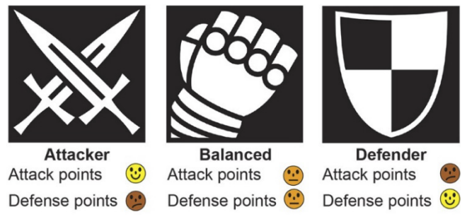
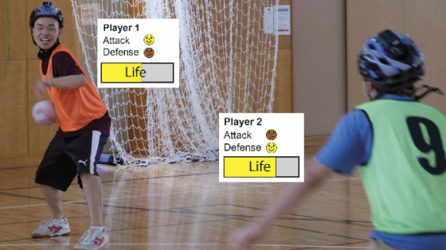
VIRTUAL CHARACTERS
Physical attributes
All participants chose a character
Separated equally
Notes:
virtual characters are there physical attributes that virtually augment their in game features. Why they would do this, is In regular Dodgeball when you get hit once you are out until someone catches a ball. In Augmenting dodgeball you can be hit once and still stay in.

Slide 12
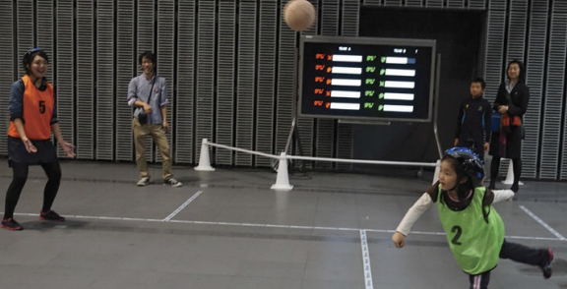
Notes:
This is the physical view of the characters that the players can see

Slide 13
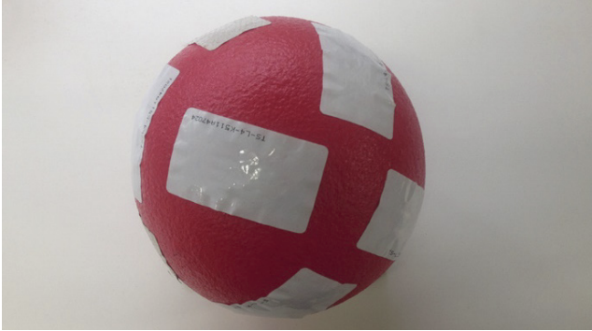

IMPLEMENTED GEAR
RFID tags
- Helmet
- Ball
RFID – RADIO FREQUENCY IDENTIFICATION
Notes:
Radio frequency identification tags on the ball are for making identification processing easier. RFID Reader is on the back of the helmet. Also has a thrower registering system on the front of the helmet because it is easier to capture the ball when the players have it.

Slide 14
PROCEDURE
2 independent game sessions held at a university
Played one regular dodgeball game
Played one augmented dodgeball game
Notes:
Each game session had 8 participants. All games were played in teams of 4. Before playing the augmented dodgeball game they were asked to chose out of three virtual characters. Before playing the augmented dodgeball game they were asked to chose out of three virtual characters.

Slide 15
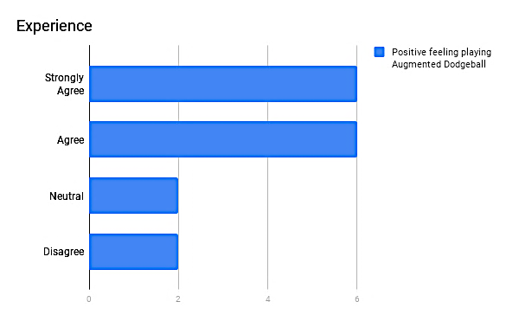
RESULTS
Positive feeling playing Augmented Dodgeball
Participants
0
2
4
6

Slide 16

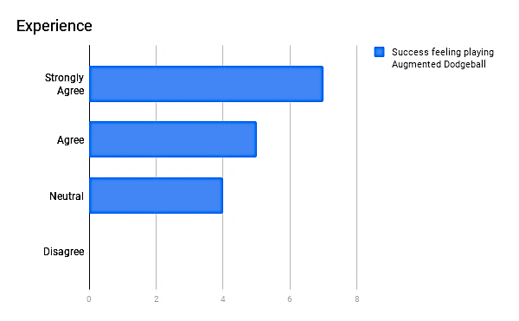
Results
Success feeling playing Augmented Dodgeball
Participants
0
2
4
6
8

Slide 17

Results
Ambition feeling playing Augmented Dodgeball
Participants
0
2
4
6
8

Slide 18
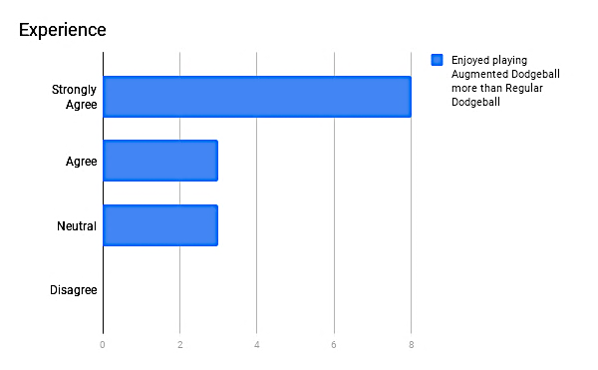
Results
Enjoyed playing Augmented Dodgeball more than Regular Dodgeball
Participants
0
2
4
6
8

Slide 19
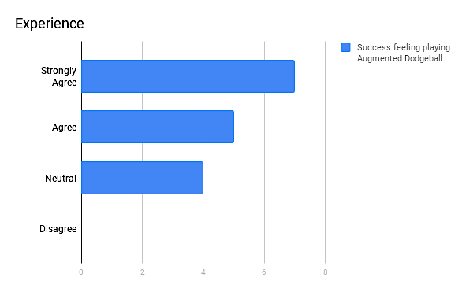


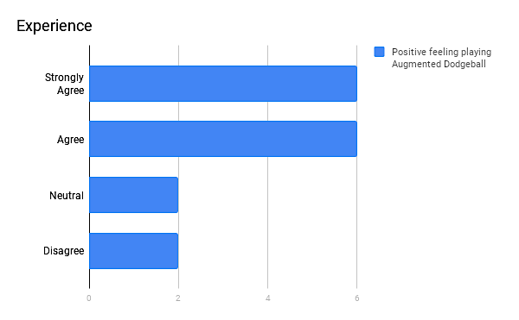
Notes:
We can see from all the graphs that augmenting dodgeball positively increases a users experience.

Slide 20
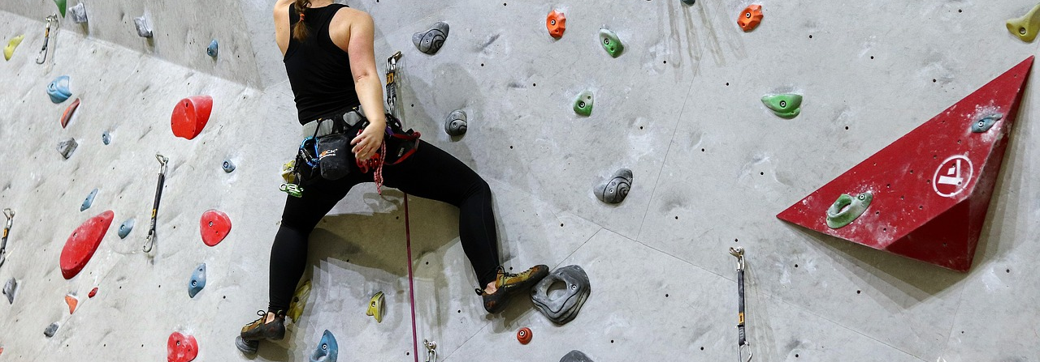
INDOOR WALL CLIMBING
Notes:
is climbing an artificial constructed wall indoors with grips or holds for hands and feet. Objective is to complete the specified route or reach the top of the wall

Slide 21
2 Interactive Games
Whack-A-Bat
Spark Game
Notes:
What I mean by interactive is that there are projections that users interact with

Slide 22
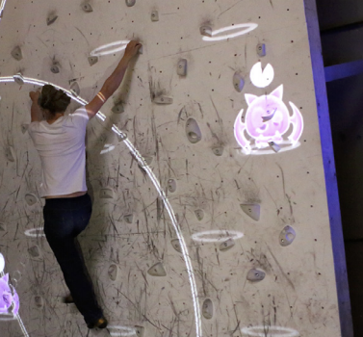
WHACK-A-BAT
Timer
Time
Random location
Game progresses more bats appear
Bat
Beacon – move the direction of the bat
Notes:
the participant attempts to touch a bat sitting on the grips before the timer runs out. When a bat is touched it flies to a random location on the wall and restarts its timer. The new locations are randomized. As the game progresses, more bats appear, this escalates the difficulty. The bats produce beacons which are for the user to visually see the direction of where the bat is.

Slide 23
PROCESS
10 participants played two games each
Played with and without the beacons
Rated each game played

Slide 24
RESULTS
Likertstyle Scale
1= Very Easy 4= Not Easy or Difficult 7= Very Difficult
With beacons | Without beacons
2.7 Mean | 4.7 Mean
1.4 Standard Deviation | 1.4 Standard Deviation
Standard deviation – Distance from the mean
Mean – The average of all the numbers
Notes:
The results tell us that playing the game with beacons is much more beneficial for the user than without beacons. The standard deviation is the same for both, this means there are a variety of results.

Slide 25
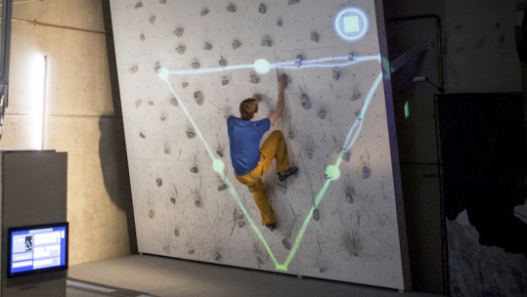
Spark Game
End Point
Electric Line
Notes:
The second game is where the climber tries to avoid touching the electric lines that are projected onto the climbing wall As the climber completes levels, the levels increasingly get more challenging such as moving electric lines and intermediate way points.

Slide 26
Three Main points
Each game level has a clear start and end
The moves can be pre-planned and done while climbing
Each level is pre-designed
Notes:
creating both cognitive and motor skills. useful because it can be practiced and one can learn the performances of others.

Slide 27
Study
50 climbers (29 male, 21 female)
Average age of 27
Average climbing experience of 2 years
Each participant played spark game twice

Slide 28
Questionnaire
What did you like the least?
What did you like the most?
How does climbing in the game differ from regular climbing?
How does watching someone play differ from watching regular climbing?
Who is this most suitable for?
Would this help your climbing practice? How?
Notes:
This is the questionnaire that the participants answered after playing Spark game.

Slide 29
Pre-Results
Open ended responses
Most relevant responses
Researchers categorized the responses (responses may have multiple categories)

Slide 30
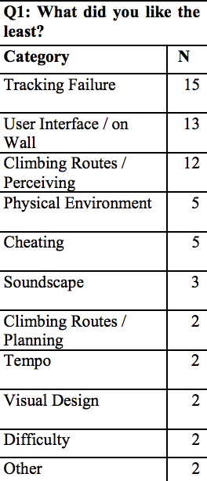
Q1 - What did you like the Least?
Q1 – “Hard to perceive one’s body on the wall” , “ Electricity borders are imprecise” – functionality
Notes:
The functionality needs to be fixed

Slide 31
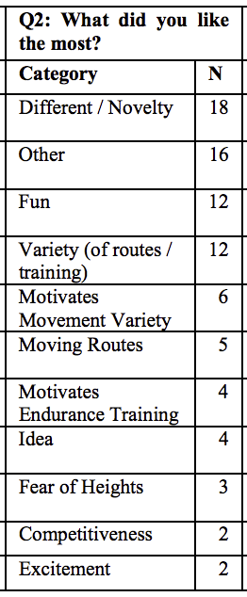
Q2 - What did you like the most?
Q2 – “Versatility, game adds excitement” , “Fun endurance practice that does not feel like practice” – warm up
Notes:
The game might be more suitable for a warm-up exercise rather than developing technique

Slide 32
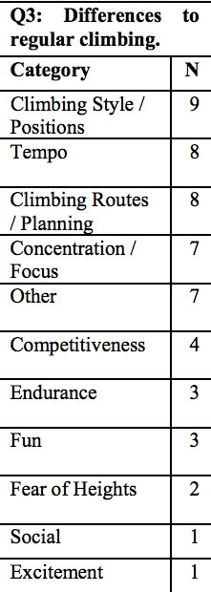
Q3 - How does climbing in the game differ from regular climbing?
Q3 – “Faster pace makes it more addictive” , “ Visual perception is used differently” – adds features
Notes:
adds multiple features to the aspect of climbing

Slide 33
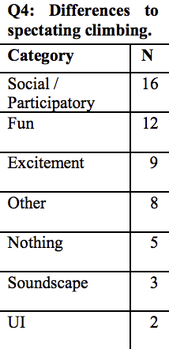
Q4 - How does watching someone play differ from watching regular climbing?
Q4 - “Can participate as a spectator by giving instructions” – new perception
Notes:
This gave spectators a new perception of having fun with sounds and visual effects.

Slide 34
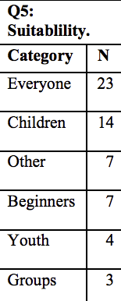
Q5 - WHO IS THIS MOST SUITABLE FOR?
“ Young kids or adults who love a competitive game ” , “Anyone who loves games and being active” – expand audiences
Notes:
the digital augmentation expands the sport's target audience

Slide 35
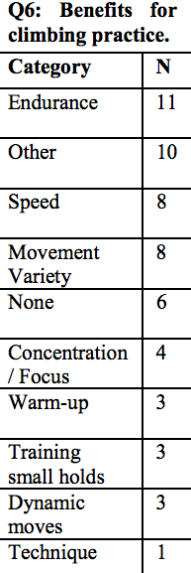
Q6 - WOULD THIS HELP YOUR CLIMBING PRACTICE? HOW?
“Yes it increases the awareness and speed of your physical attributes” – helps climbers
Notes:
Helps a variety of climbers to be better.

Slide 36
Unique Results
“ I forgot the fear of heights and falling” – Shifts the focus of the environment
“Excitement provided by the game at one meter above the ground” – adrenaline junkie
Notes:
The application created a more focused environment that made the climber literally forget she was climbing instead of playing a game. This comment seems to be an adrenaline junkie that enjoying this game as much as climbing a mountain.

Slide 37
Conclusion
The studies indicate when playing a sport implemented with an augmented system the involvement, experience, and enjoyability of the players are all positively affected.
Notes:
The studies indicate when playing a sport implemented with an augmented system the involvement, experience, and enjoyability of the players are all positively affected.

Slide 38
acknowledgements
Kristin Lamberty, Elena Machkasova, Family, and Friends for all the guidance and feedback

Slide 39
Questions?

Slide 40
References
Kadri Rebane, Takahiro Kai, Naoki Endo, Tomonari Imai, Takuya Nojima, Yohei Yanase
The 8th Augmented Human International Conference, March 2017
https://dl-acm-org.ezproxy.morris.umn.edu/citation.cfm?id=3041181
Raine Kajastila, Leo Holsti, Perttu Hämäläinen
The 2016 CHI Conference on Human Factors in Computing Systems, May 2016
https://dl-acm-org.ezproxy.morris.umn.edu/citation.cfm?id=2858450

